Slide 1
Kafka overview

Slide 2
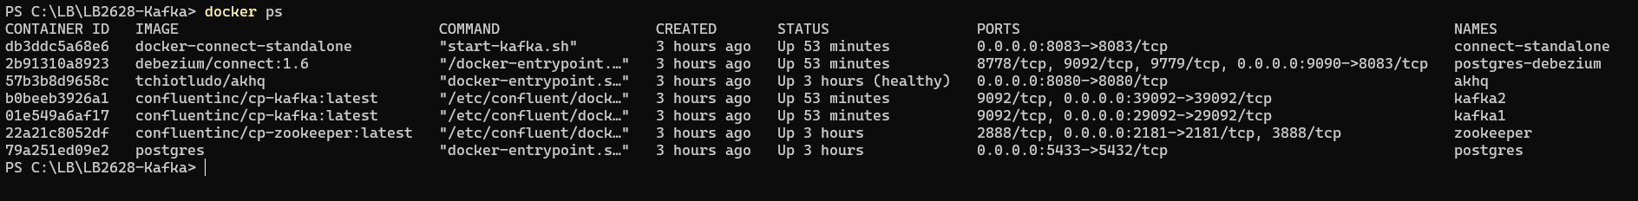
Exercise
Start kafka cluster
Make sure DockerDesktop is running
Open PowerShell and navigate to <project-folder>/docker
Run command docker run hello-world to see if docker I up and running
Type docker-compose.exe up –d
This will start a cluster with one zookeeper server and two Kafka brokers in detached mode.
Expect 5 min install time!
Make sure to keep this window running
All services are running in docker containers. The two brokers are exposed on port 29092 and 39092 on the host network
Open a new PowerShell window and navigate to <project-folder>/docker
Type docker ps
You should see something like this, showing all running containers:
2.1

Slide 3

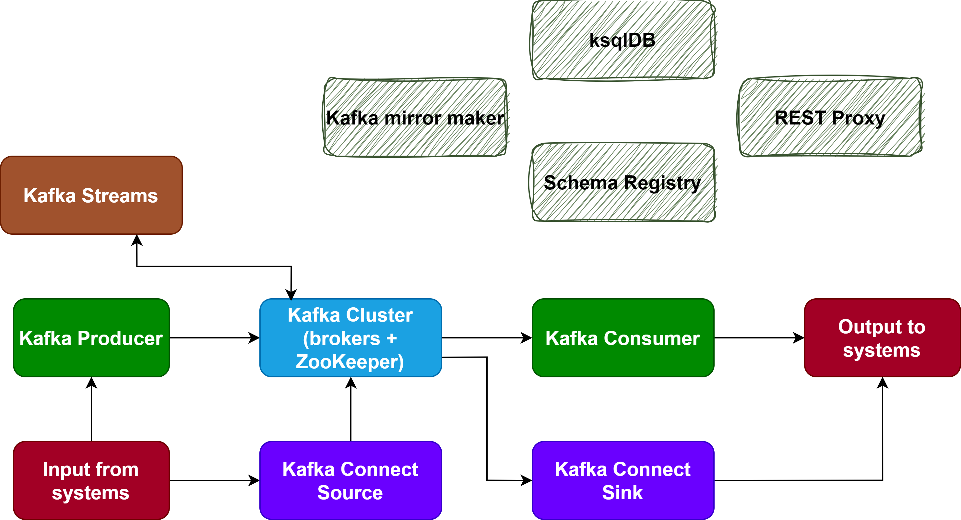
Kafka overview
Kafka was originally built by LinkedIn to handle the growing amount of data streams in the company. Later it was open sourced. It’s a distributed log optimized for high-throughput. Today it is used by many companies because of its flexibility and additional features build around it like Kafka Streams, a declarative DSL API to simplify stream-processing, Kafka Connect, an integration product that provides pluggable connectors to consume and produce to/from external data stores. The name Kafka was chosen by one of the founders of Kafka, Jay Kreps, because he liked the author Franz Kafka, and he thought the product was optimized for writing.
Producer: A producer is a component or application that publishes (produces) events or messages to Kafka topics.
Consumer: A consumer is a component or application that subscribes (consumes) events or messages from Kafka topics.
Broker: Kafka clusters consist of one or more Kafka brokers, which are responsible for storing and serving events. Each broker is a Kafka server.
ZooKeeper: Used for distributed coordination and management of Kafka brokers (control plane).
Kafka Streams: client-side DSL API to build event stream pipelines
Kafka Connect: Framework to integrate data-sources & sinks with Kafka
Mirror maker: Replicate between two Kafka clusters
Schema Registry: Enforce message schema compliance for producers & consumers
REST Proxy: Proxy for non-java clients
ksqlDB: SQL like stream processing for data analysis

Slide 4
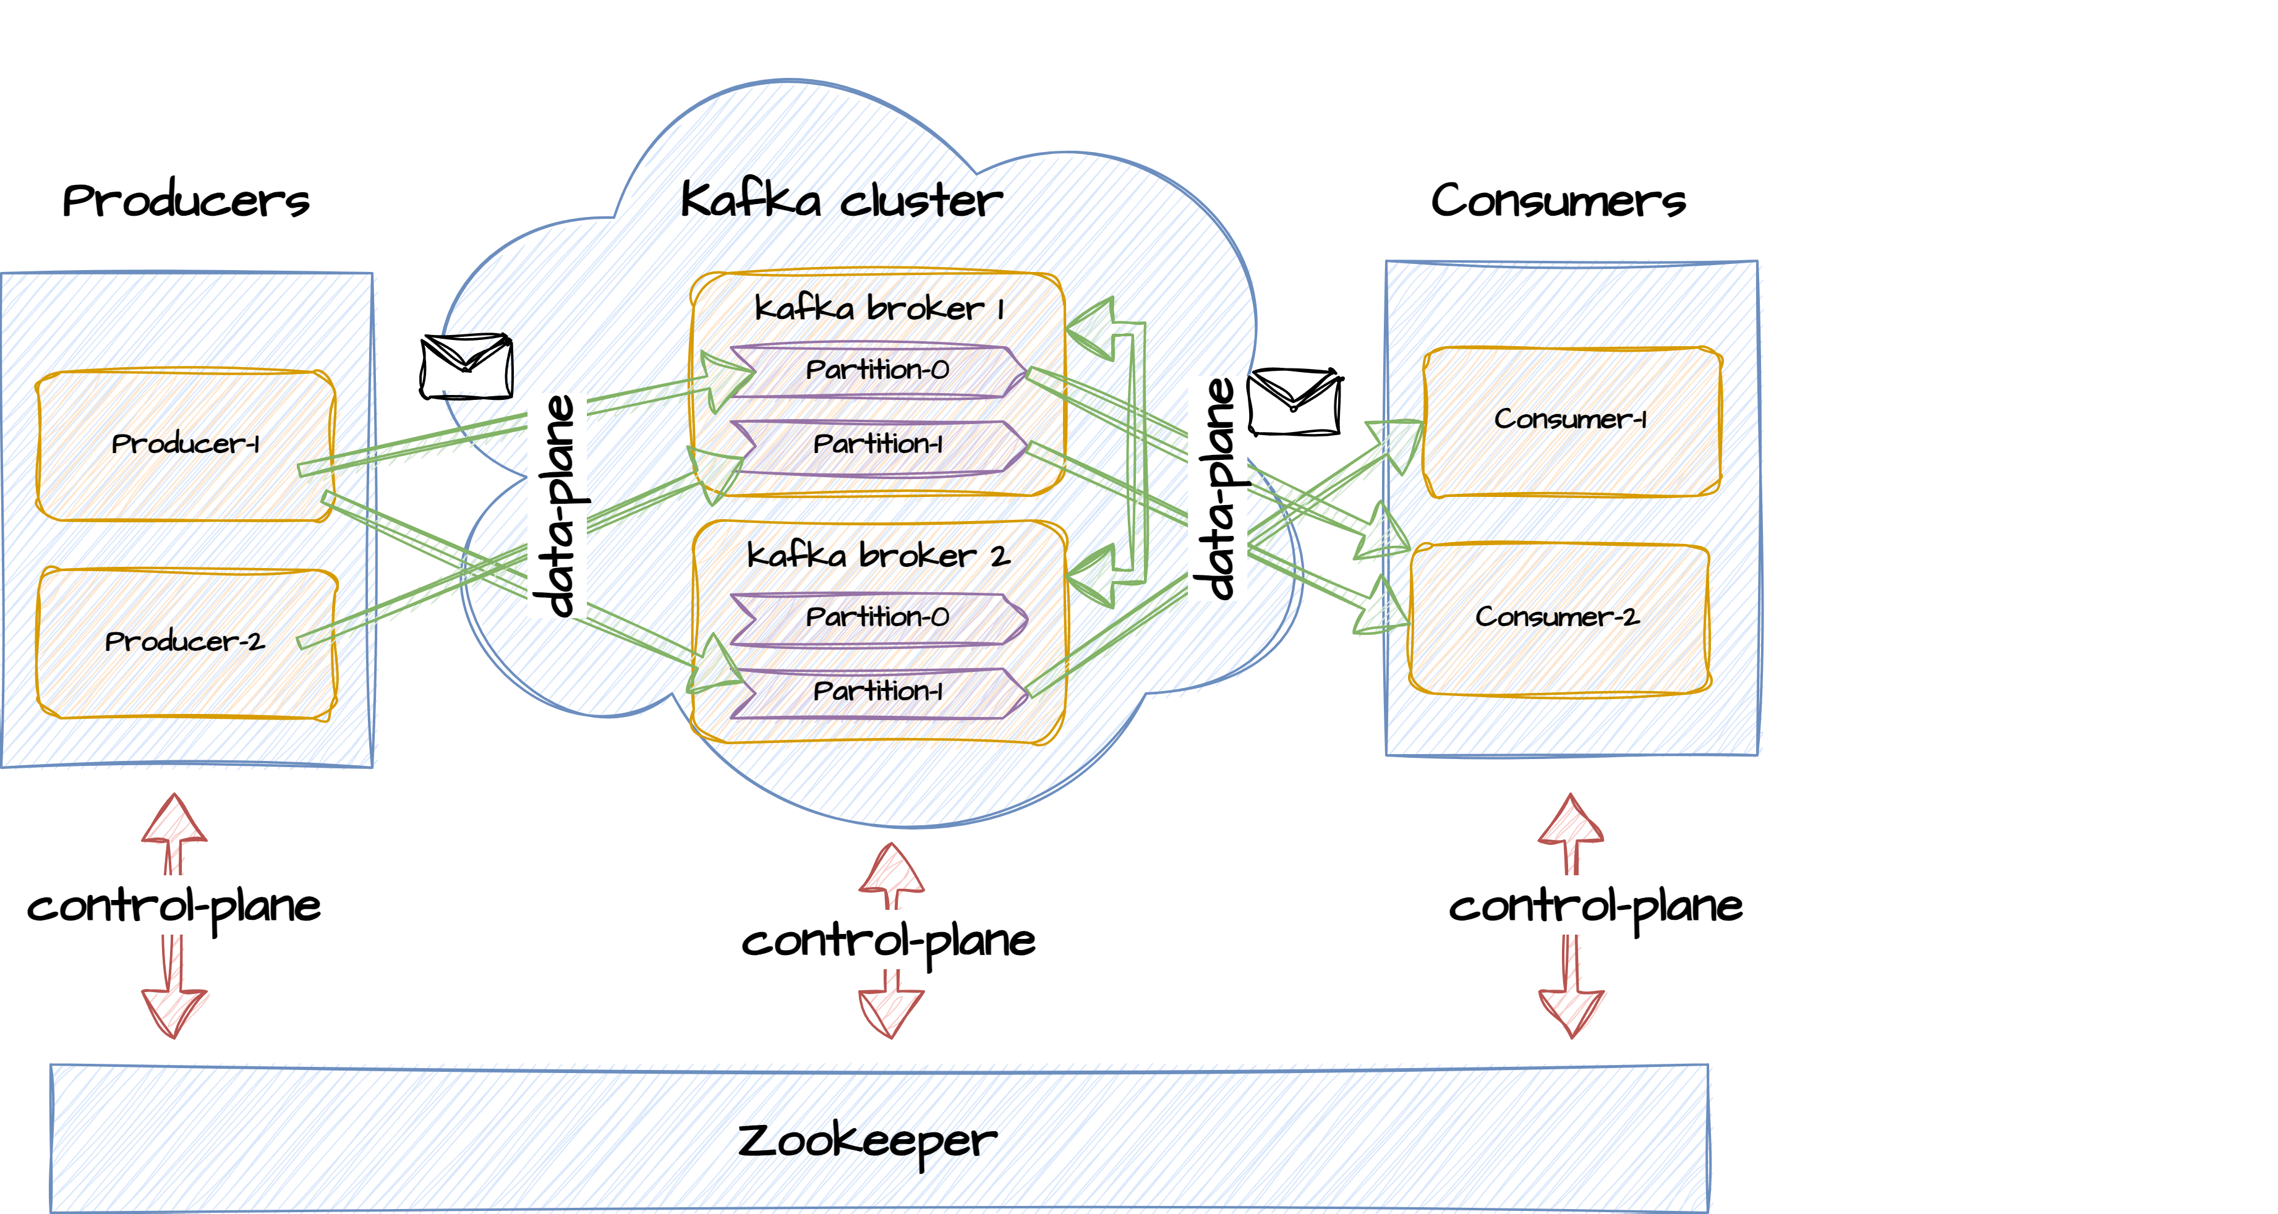
Kafka overview

Slide 5
Who uses Kafka?
https://kafka.apache.org/powered-by
Many companies across various industries use Apache Kafka for real-time data streaming and event processing. Some well-known companies that have publicly disclosed their use of Kafka include:
LinkedIn: Kafka was originally developed by LinkedIn, and the company continues to use it extensively for various data processing needs.
Netflix: Netflix uses Kafka for real-time data streaming to enhance its streaming services and content recommendations.
Uber: Uber employs Kafka for real-time data processing and analytics to support its ride-sharing platform.
Airbnb: Airbnb uses Kafka to power its data infrastructure, enabling real-time data processing for various services.
Twitter: Twitter utilizes Kafka to handle a massive amount of real-time data generated by its social media platform.
Pinterest: Pinterest relies on Kafka for real-time data processing and analytics to enhance user experiences.
Walmart: Walmart uses Kafka to process and analyze large volumes of data to improve supply chain management and customer service.
Slack: Slack uses Kafka to support real-time messaging and communication services.
Goldman Sachs: Goldman Sachs utilizes Kafka for real-time data processing in financial services and trading.
The New York Times: The New York Times uses Kafka for real-time analytics and data processing to enhance its digital content delivery.
PostNord ☺

Slide 6
How kafka works
Publishing Events (Producer):
Producers send events to Kafka topics. Each event is associated with a specific topic.
Producers typically batch events for efficiency and send them to Kafka brokers over a network connection.
Producers can choose to send events to a specific partition within a topic or allow Kafka to choose a partition using a partitioning strategy (e.g., round-robin, key-based).
Storing Events (Broker):
Kafka brokers receive and store events in their distributed log data store. Each event is appended to the appropriate partition.
Events are assigned sequential offsets within their partitions. Offsets serve as unique identifiers for events within a partition.
Replication:
Kafka provides data replication for fault tolerance. Each partition has multiple replicas distributed across different brokers.
Replication ensures that events are not lost if a broker fails. One replica is designated as the leader, and others are followers.
Producers send events to the leader replica, and followers replicate the data from the leader.

Slide 7
How kafka works
Consuming Events (Consumer):
Consumers subscribe to Kafka topics and specify the partitions they want to consume from.
Kafka allows multiple consumers to subscribe to the same topic and partition, enabling parallel processing.
Consumers read events from their assigned partitions sequentially based on their offsets.
Retention and Cleanup:
Kafka retains events for a configurable period (retention period) or until a certain size threshold is reached.
Events that have been consumed are not immediately deleted but are marked for deletion based on their offsets.
Kafka uses a garbage collection process to reclaim disk space by deleting expired events.
Scaling:
Kafka is designed to be horizontally scalable. You can add more brokers to a Kafka cluster to increase capacity.
Partitions can be added to topics to distribute the workload and accommodate higher throughput.

Slide 8
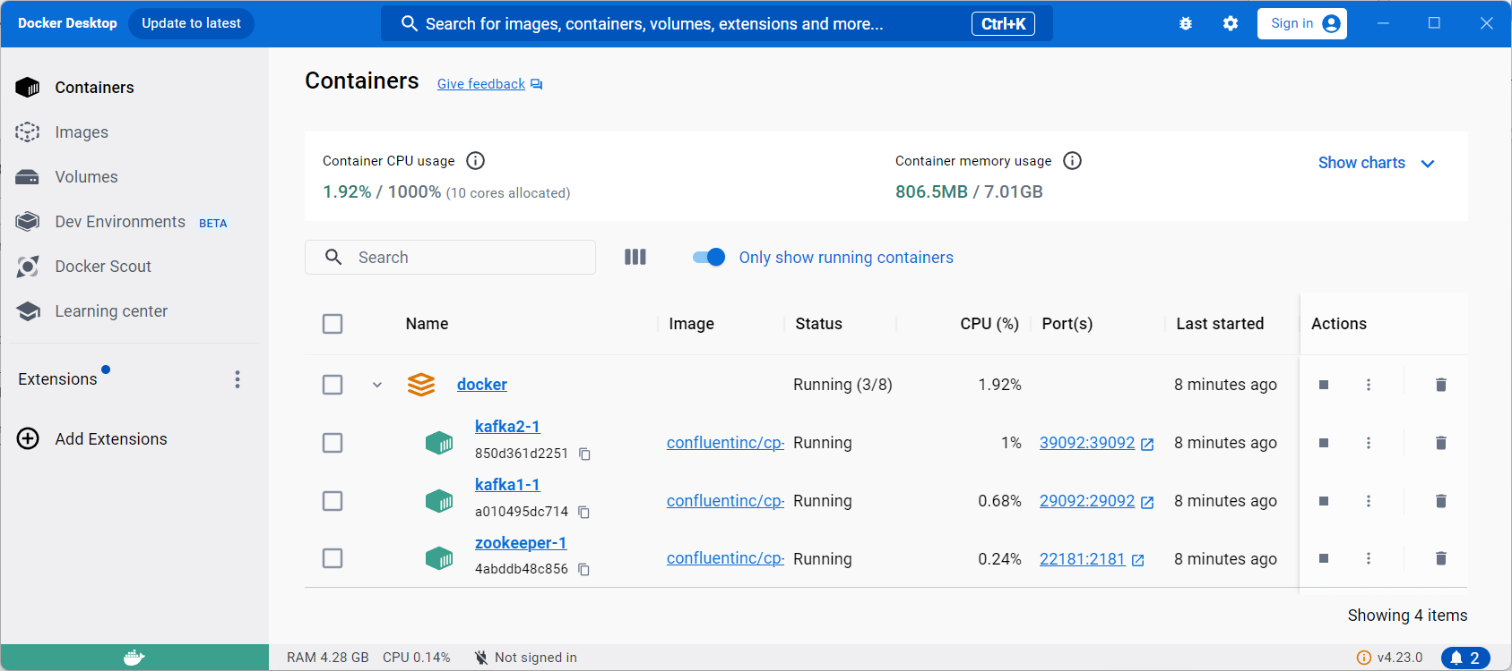
Exercise
Open Docker Desktop
In the taskbar type ‘docker desktop’ and open the application
You should see something like the below window showing all running containers.
Docker desktop provides a user-friendly interface to see running containers.
Here you can start, stop and delete containers
Walk-through of the deployment and the containers
2.2

Slide 9
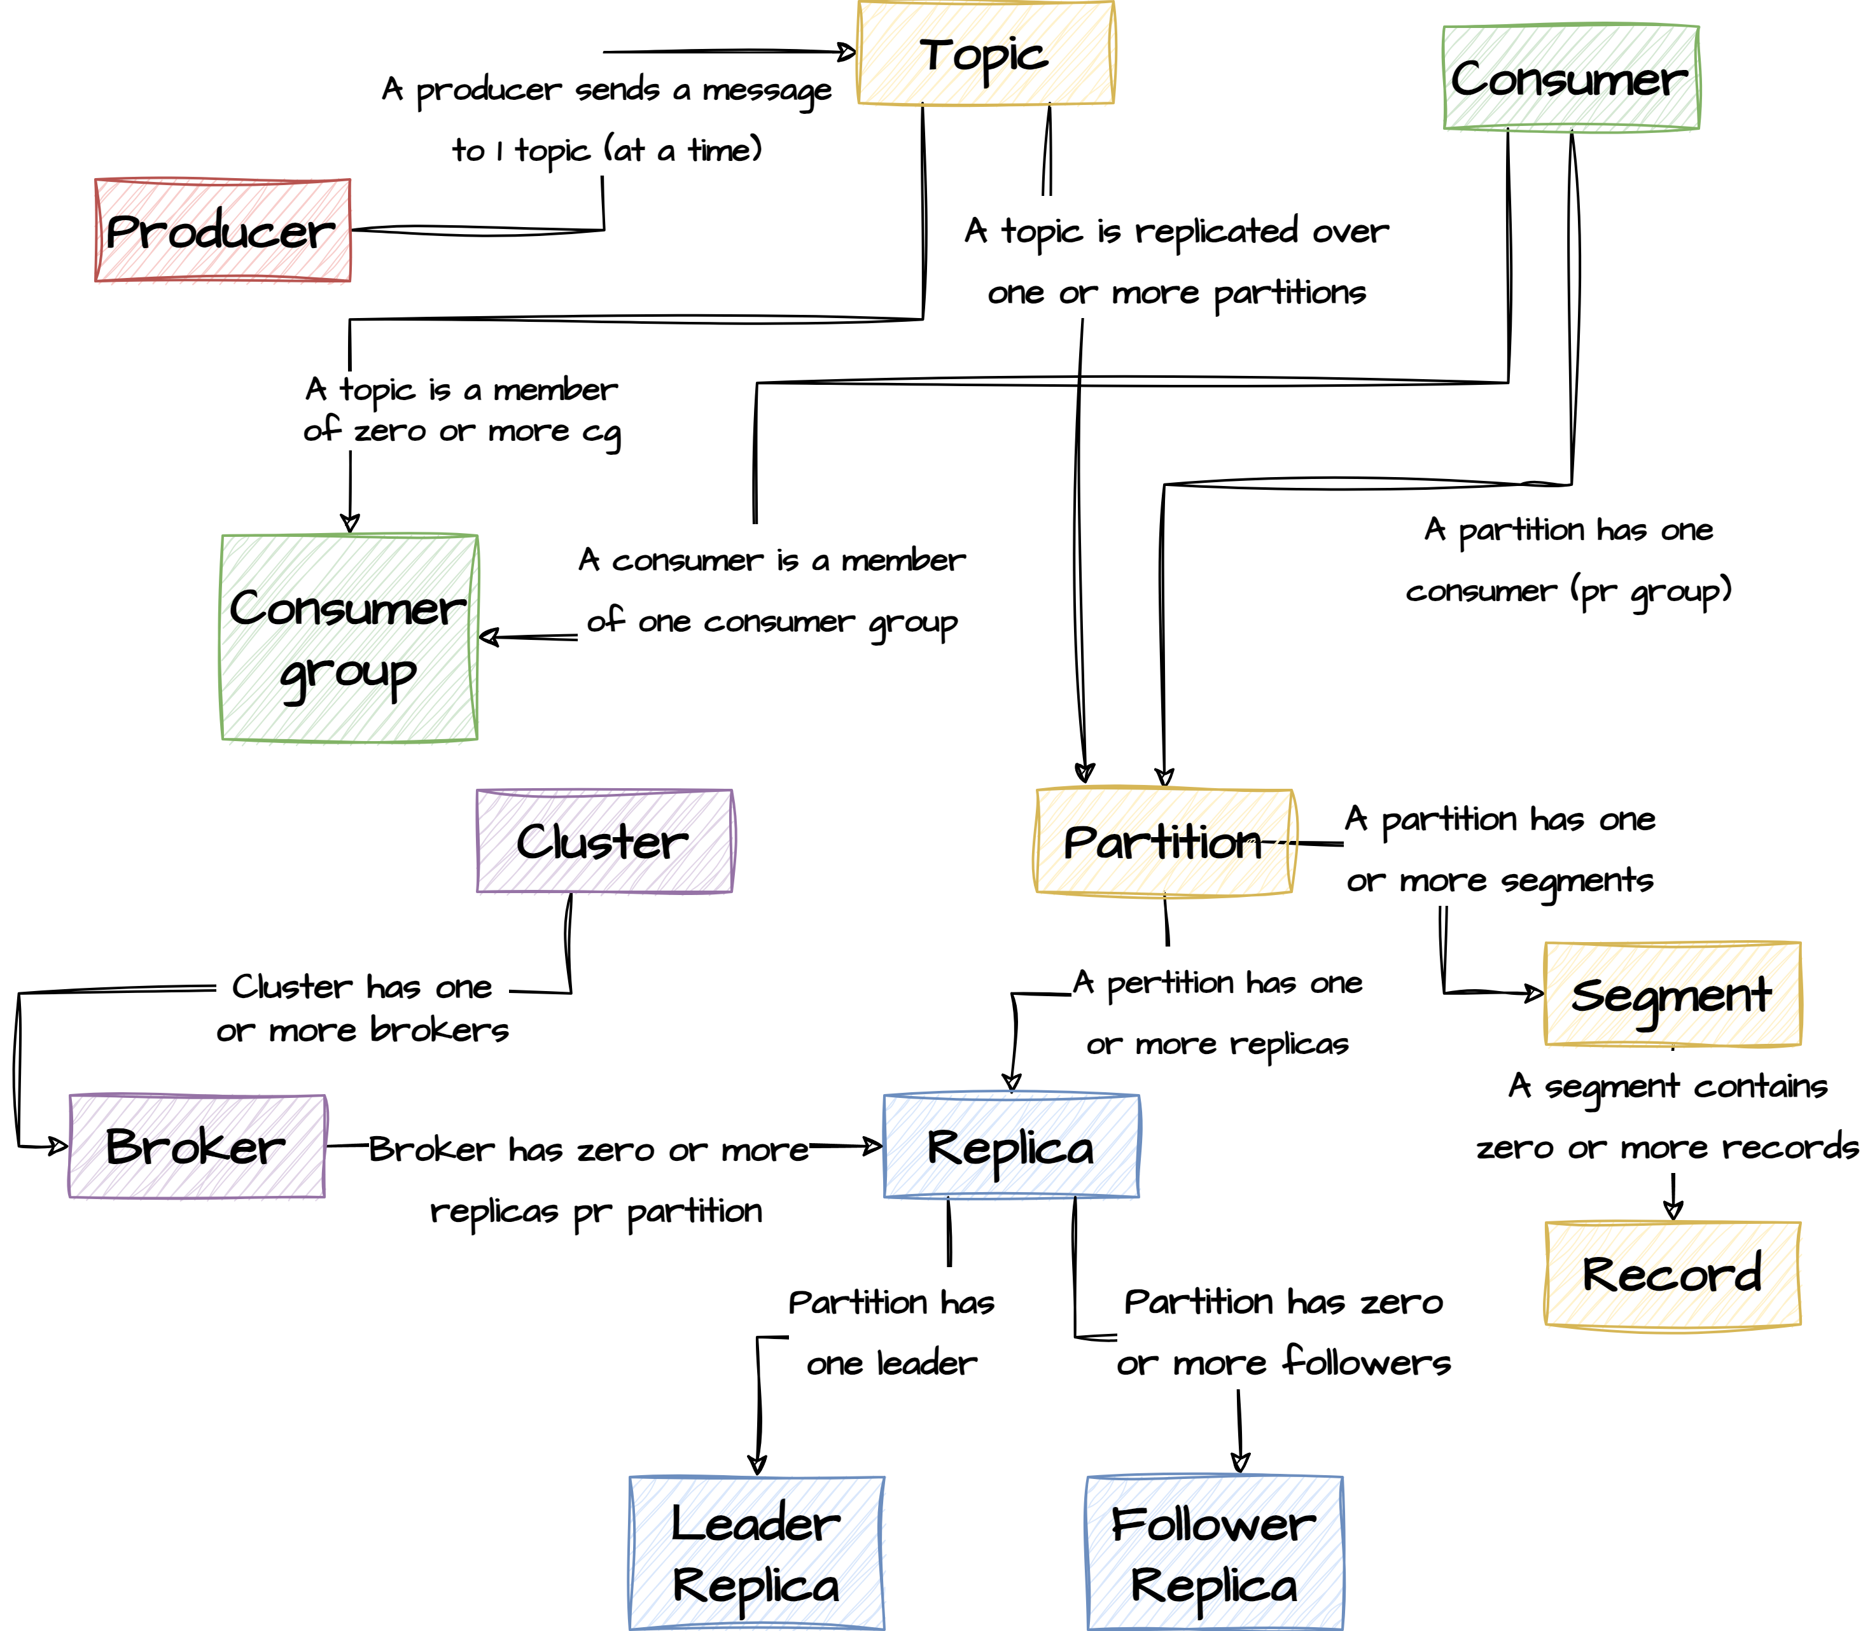
Kafka relational diagram

